Slide 1


SMART INDIA HACKATHON 2024
TITLE PAGE
Problem Statement ID –1597
Problem Statement Title- Empowering Healthcare Access with Tailored EMI Solutions
Theme- Med-Tech/Bio-Tech/Health-Tech
PS Category- Software
Team ID-15
Team Name- W5

Slide 2
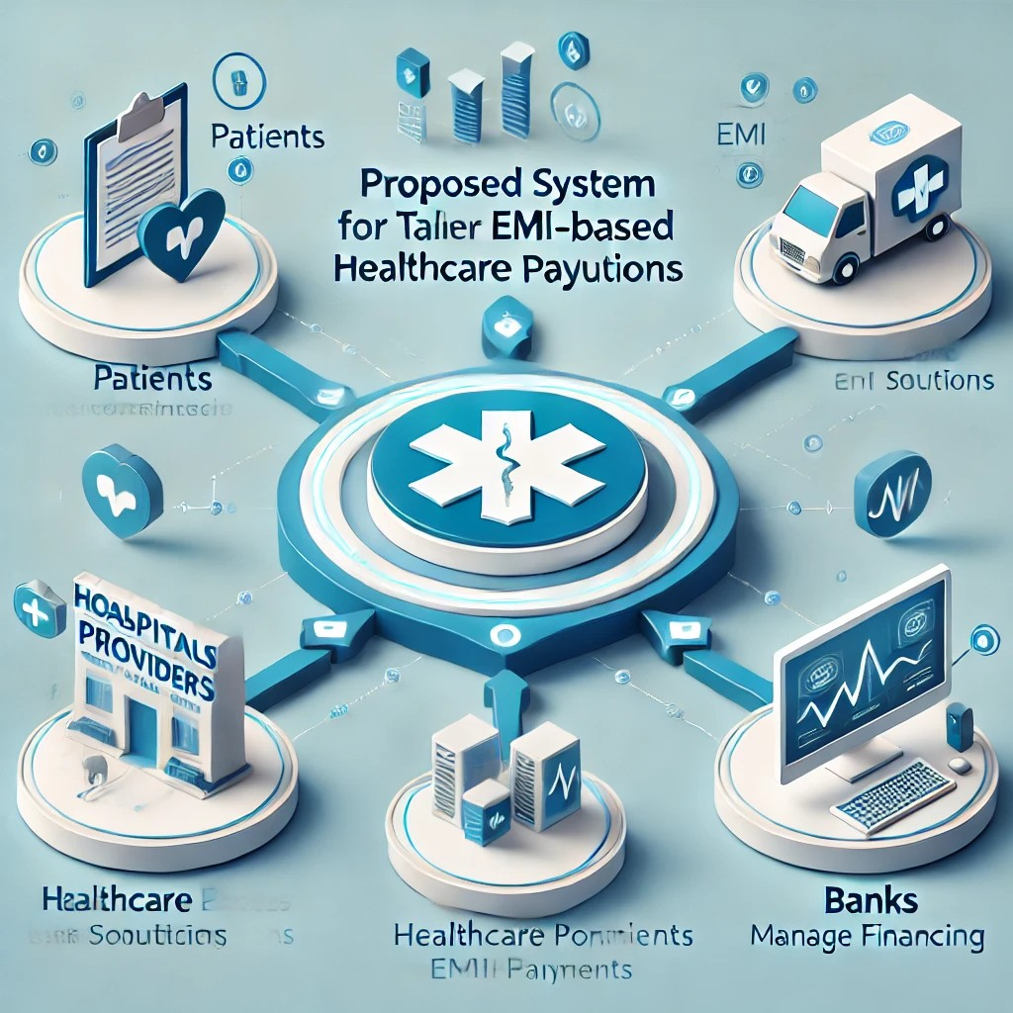
Developing a Digital Platform for Tailored EMI Solutions in Healthcare
W5
Proposed Solution
It involves creating a comprehensive digital platform that integrates banks, healthcare providers, and patients.
This platform will enable patients to manage their medical expenses through flexible and personalized EMI plans, making high-quality healthcare more accessible and affordable.

Slide 3
TECHNICAL APPROACH
W5
Technologies to be used :
HTML/Javascript: For building UI(User Interface)
SQL Databases
Banking API’s
Java
Python

Slide 4
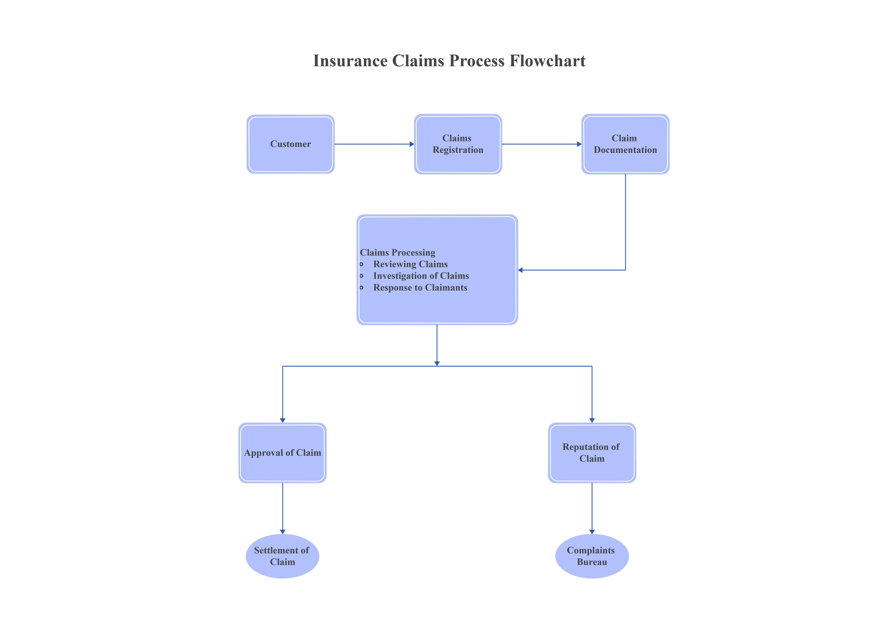
FEASIBILITY AND VIABILITY
W5
FEASIBILITY:
1.Financial Feasibility
2.Diverse Patient Needs
3.Credit Score
RISKS:
1.Regulatory and Compliance Risks
2.Market Adoption Risks

Slide 5
IMPACT AND BENEFITS
W5
The solution will significantly reduce the financial barriers to accessing healthcare.
Patients will no longer have to delay or forgo essential treatments due to cost concerns, leading to better health outcomes.
Additionally, healthcare providers will benefit from more reliable payment streams, and banks will gain new customers through their involvement in healthcare financing.

Slide 6
RESEARCH AND REFERENCES
W5
https://www.netsolutions.com/insights/5-healthcare-problems-which-digital-technologies-can-solve-for-a-fit-and-healthy-world/
https://www.webmd.com/

